Slide 1
Experiments with G3 Files
Jonah Lee

Slide 2
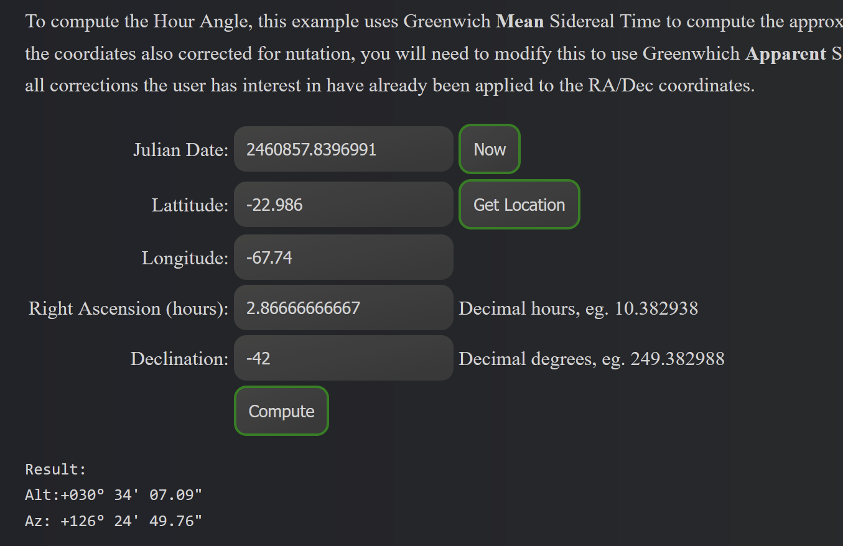
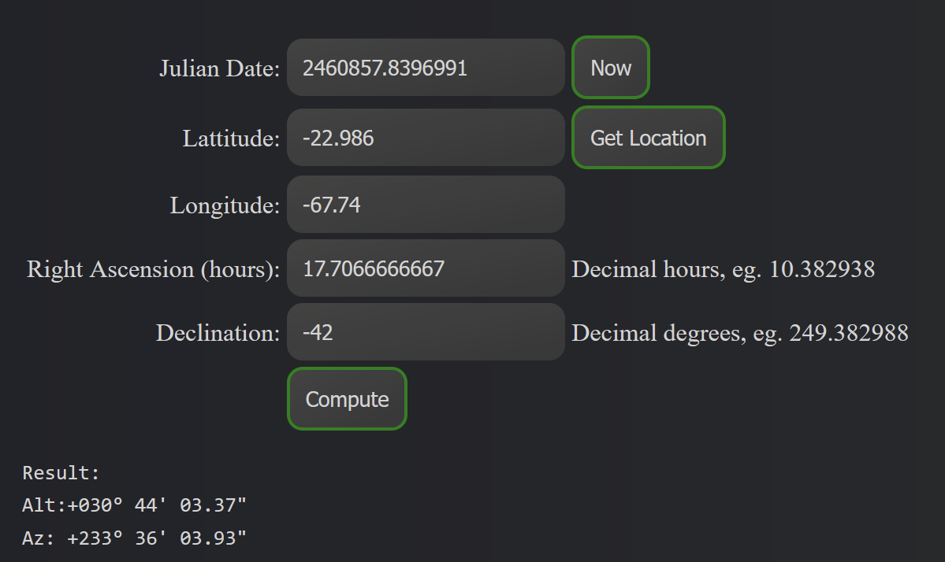
Figuring out Ra/Dec for Sourav’s sample data
http://www.stevegs.com/utils/jd_calc/
https://astrogreg.com/convert_ra_dec_to_alt_az.html
→ Only the first one lines up with the 126deg az

Slide 3
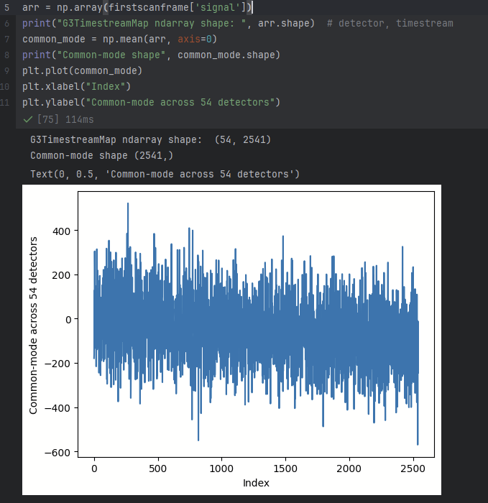
Computing Common-Mode

Slide 4
TOAST / G3
https://toast-cmb.readthedocs.io/en/toast3/tutorial_intro.html
How does the TOAST “focalplane” object work?

